Slide 1
Emergency Management
What Elected Officials Should Know
Presented by
Brenda Hunemiller
Area D Office of Disaster Management

Slide 2
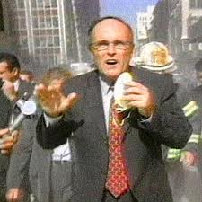
What Everyone is Concerned About
The #1 question asked by City Council members
What am I supposed to do during a disaster?
What is my role and responsibility?
The #1 concern of city staff
City Council members don’t know what they are supposed to do during a disaster
They don’t know their role and responsibility

Slide 3
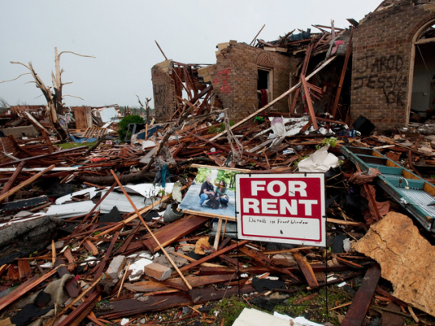
The Basics
What is emergency management?
It is a cycle
Focus on “preparedness”
You have responsibilities in each of the phases

Slide 4
Emergency Management
Preparedness
Mitigation
Response
Recovery

Slide 5
Emergency Management
Preparedness
Plans, Training, Exercises, Public Education, Outreach and Inclusion of Community

Slide 6
Plans
Emergency Operations Plan
Is it up to date?
Is it inclusive to all community members?
Did the community assist in developing the plans?
Is there a City Council checklist?
If yes, do you have a copy? Have you “personalized” it?
If no, why not?
Local Hazard Mitigation Plan
What you don’t know could cost you millions!
Do you have one? When was it last updated?
Has it been updated and approved by FEMA?

Slide 7
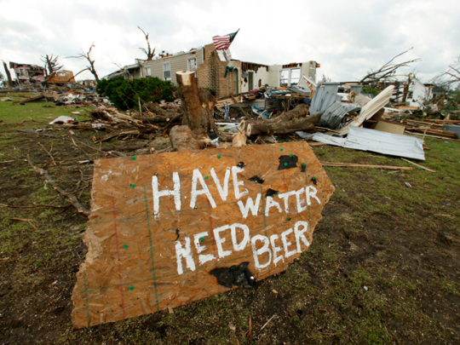
Plans (con’t)
Recovery Plan
Do you have one?
BCP, COOP
You will be critical in developing and implementing this plan
It is a roadmap for rebuilding, revitalizing and restoring your community!

Slide 8
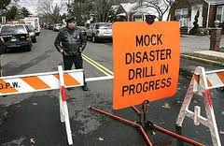
Training and Exercising
Officials and staff trained and exercised?
SEMS and NIMS
EOC Training
Regular exercises
Do you participate?
Are community partners invited to participate?

Slide 9
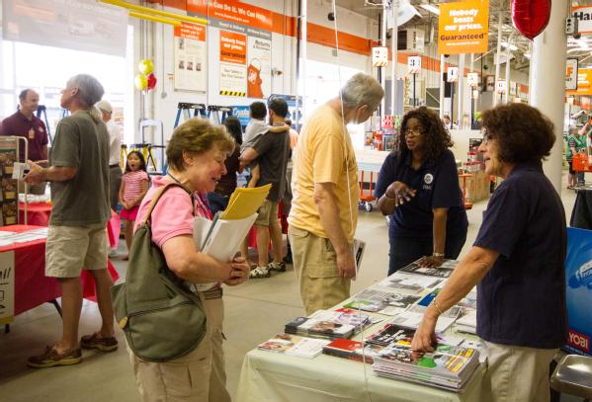
Public Education
More than a piece of literature on the counter
Is your city providing ongoing opportunities to residents and businesses?
Are you prepared?

Slide 10
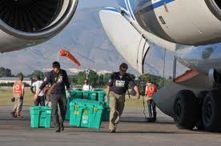
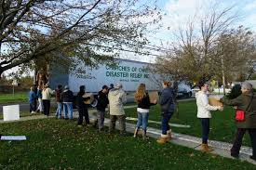
Working Together Before the Disaster
Has your city built partnerships among all sectors of your community?
FBOs, CBOs
American Red Cross & others
Hospitals
Private Sector/Businesses
Schools/Higher Education
Volunteer groups
CERT
DAFN groups

Slide 11
Emergency Management
Preparedness
Stabilizing, Restoring, Assessing, Initial Damage Estimate, Emergency Public Information
Response

Slide 12
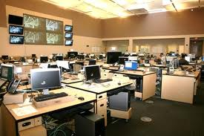
Activating the EOC
Coordinates all activities, information and resources
“Big Picture”
EOC Management
Works directly with the City Council
Priorities and objectives
Policies, emergency ordinances, etc. to assist and support response efforts
City of Los Angeles EOC

Slide 13
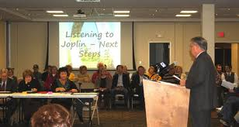
City Council to Designated Location
Family first
Report to the City
Get a briefing
How bad is it?
What kind of help do we need?
What are our priorities?
What do you need from the City Council?

Slide 14
A State Of Emergency
Do we need to proclaim a local emergency?
At least two of the following criteria should be met:
Actual condition of extreme peril to persons and property
Imminent threat of extreme peril to persons and property
The means to resolve conditions of extreme peril will probably exceed the capability of the jurisdiction (need for mutual aid)
There is a need to protect those who must provide emergency services (legal immunities)

Slide 15
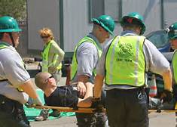
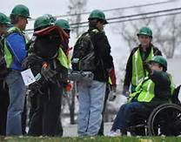
Out On The Streets
Priorities set by the EOC
Stabilize incidents
Life Safety
Property
Environment
Directing community actions
CERT
Contact with all community partners

Slide 16
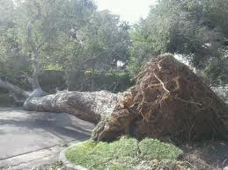
Out On The Streets (con’t)
Priorities set by the EOC (con’t)
Restore essential services
Assessing the damage
Initial Damage Estimate (IDE)

Slide 17
IDE Process
What exactly is an IDE and why is it important?
The IDE is what brings FEMA to town!
IDE is an ESTIMATE of the amount of damage your city has sustained to homes, business and government
It is a GUESS....you will not be penalized for overestimating the amount of damages
Underestimating the amount could cost everyone reimbursement!

Slide 18
Thresholds
To qualify for Federal assistance through the Robert T. Stafford Act
Dollar losses must reach thresholds for both the state and county (formula for 2010)based on population from last census (2010)
Los Angeles County
County: $3.23/population (9,818,605) = $31,714,094
State: $1.29/population (37,253,956) = $48,057,603

Slide 19
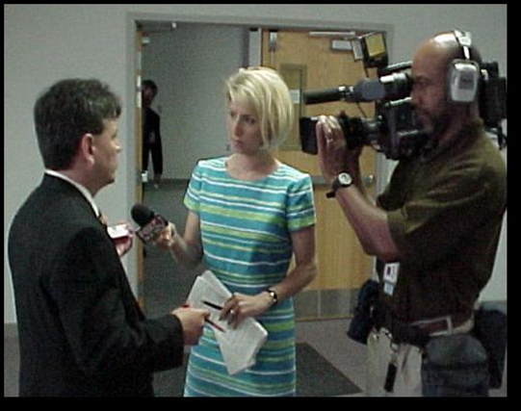
When The Media Comes To Town
Working with the media
BFFN or WN?
Your city and dept PIOs become a HUGE asset
They prepare and schedule briefings for the media
Make sure you get a copy of the news releases they are giving the media
They can give you tips, hints, do’s and don’ts when talking to the media

Slide 20
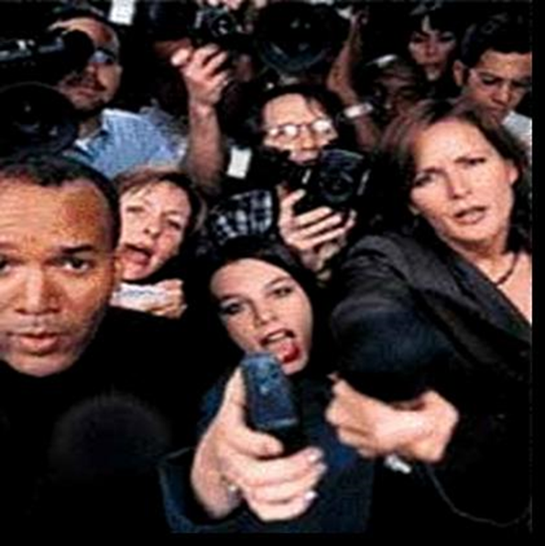
The Interview
Lessons learned from Rudy
Start with message of sympathy
Followed by message of hope
Followed by the facts
You have a piece of paper in your hand with the latest info
Don’t rely on your memory for facts
Don’t talk to them unless:
You have been briefed in the last 15-20 minutes

Slide 21
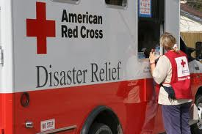
Community News
What your residents and businesses need to know
What is being done for them?
Where can they get what they need?

Slide 22
Emergency Management
Preparedness
Response
Returning the community to the new “normal”, economic continuance
Recovery

Slide 23
The Process
Local State of Emergency
County
= no $
State
= no $
Federal
= $ and assistance
No Federal
=
Assistance to homeowners and businesses only

Slide 24
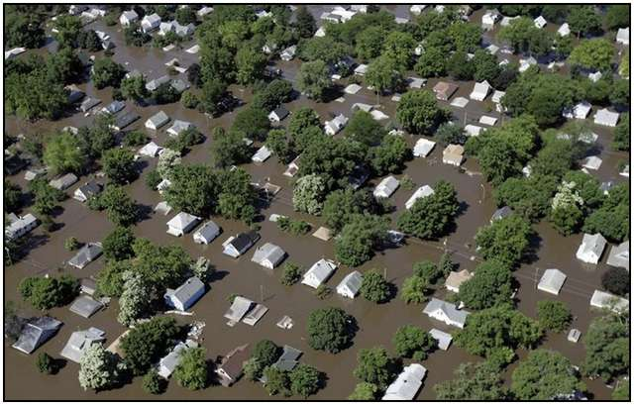
Asking for Federal Assistance
FEMA/State will send Preliminary Damage Assessment (PDA) teams to meet with local jurisdictions
City Managers, Mayors, Council members should meet with them

Slide 25
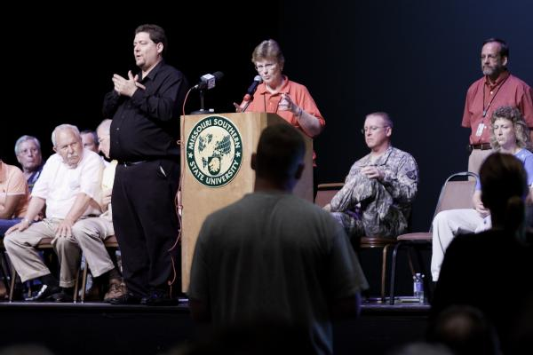
Rebuilding the Community
Implement the city Recovery Plan
Short Term, Mid-Range and Long Term Issues
Housing
Economic Stabilization
Rebuilding, Restoring
Zoning
Construction Codes
You will be involved in all aspects of recovery

Slide 26
Emergency Management
Preparedness
Mitigation
Lessening the impact of future disasters based on lessons learned
Response
Recovery

Slide 27
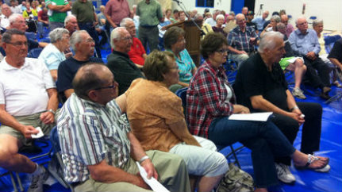
Post Disaster Mitigation
Federal grants
Designed to stop repetitive damages
You must have a Local Hazard Mitigation Plan
You will be instrumental in identifying mitigation projects and activities

Slide 28
And It Keeps Going….
Preparedness
Mitigation
Response
Recovery

Slide 29
The Don’ts
Don’t make promises you can’t keep
Don’t forget to follow up on issues
Don’t talk to the media unless you have had a briefing in the last 15-20 minutes
Don’t place blame
Don’t guess as to cause

Slide 30
The Do’s
Do keep city staff informed about concerns and issues of the community
Do have a scribe
Do support emergency management by funding staff positions and activities
Do participate in planning, training and exercises
Do ask questions
Do get prepared

Slide 31
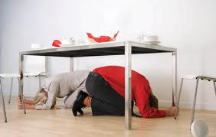
The Bottom Line
It isn’t the responsibility of just one person
It IS the responsibility of everyone
It IS making sure that every day we are as prepared as we can be through planning, training and exercising

Slide 32
Emergency Management and the American Red Cross
Disaster Partnerships Overview
Brandy Welch, Regional Partner and Emergency Management Agency Function Support Manager
American Red Cross Los Angeles Region

Slide 33
American Red Cross Los Angeles Region
4 Counties: Los Angeles, Inyo, Mono, Portion of Kern
Tribal Nations in both Inyo and Mono Counties
88 cities within Los Angeles County/~30 distinct FDs
~10 million residents in LA County
~200 distinct neighborhoods with ~240 languages spoken
4 commercial airports and several smaller airfields
2 Large Ports
Over 10 large venues, including two 100,000 capacity stadiums
7 Major university systems with 100s of smaller 4 year and community colleges
Large tourist population (40 million+ in 2011 and 2012)

Slide 34
Disaster Partnerships Stakeholders
Local Jurisdictions
Operational Areas
VOADs
Non-Profit Organizations
Private Sector

Slide 35
American Red Cross 5 Lines of Service
Biomedical
Health & Safety Services
Service to Armed Forces
International Services
Disaster Services

Slide 36
American Red Cross and Local Government
Capacity Building-
Shelter Identification
Training for DSWs
EOP Review/Planning Efforts
Communications-
Updates on National Red Cross Operations
Quarterly Updates on Local Responses and Planning
Coordination for Drills/Exercises
Activations-
Disaster Action Teams
Liaisons to EOC/ICP
Shelters, Canteen Operations, Feeding
Casework
Information Sharing to Community Stakeholders

Slide 37
American Red Cross Resources Available
Preparedness Training and Materials
Apps
Safe and Well Linking
Disaster Training
Stakeholder Coordination/Collaboration
Long Term Recovery Support
Business Continuity Programs- Ready Rating Program

Slide 38
Thank You

